Slide 1

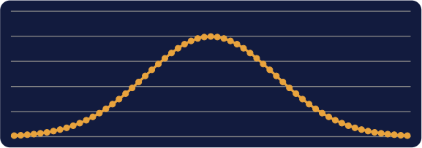

PROBABILITY AND STATISTICS
IN ARTIFICIAL INTELLIGENCE
Understanding Uncertainty in AI
Instructor Lecture Deck • Undergraduate AI / CS Curriculum

Slide 2

OPENING
Why Probability Matters inAI
• AI systems almost never have complete, noise- free information.
• Inputs are noisy, models are imperfect, and future events or labels are uncertain.
• So AI cannot only produce an answer -- it must also express how confident it is.
• AI does not only predict. AI must also reason under uncertainty.
Input (image) |  | AI Model |  | Prediction + Uncertainty
Cat: 0.75
Dog: 0.20
Other: 0.05

Slide 3
OPENING
Probability Across AI
Supervised Learning
Uncertainty in
predicting y from x
Unsupervised
Learning
Modeling the
population distribution
Reinforcement
Learning
Uncertain transitions and returns
Generative AI
Distributions over possible outputs

Slide 4
OPENING
Chapter Roadmap
01
Probability Foundations
02
Probability Distributions
03
Statistical Inference
04
Probabilistic Models in AI
05
Practical AI Applications
From axioms and distributions, to estimating parameters, to probabilistic AI models, to real systems.
Suggested 3-lecture split: Lecture 1 = Slides 1-23 | Lecture 2 = Slides 24-50 | Lecture 3 = Slides 51-70 | Appendix (71-77) optional

Slide 5


01
Probability Foundations
Axioms, random variables, conditional probability, Bayes, LLN & CLT, entropy

Slide 6
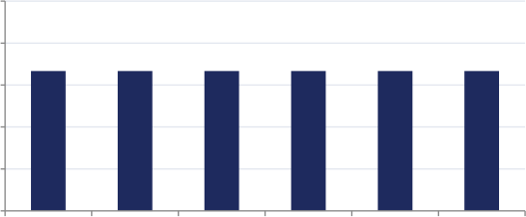
PART I - FOUNDATIONS
The Axioms of Probability
• Sample space Ω: the set of every possible outcome.
• Event A: any subset of Ω we care about.
• P(A): the probability assigned to event A.
• Kolmogorov's three axioms (1933):
• Non-negativity: P(A) ≥ 0
• Normalization: P(Ω) = 1
• Countable additivity: disjoint events add up
Die-Roll Example
Ω = {1,2,3,4,5,6}
A = “even” = {2,4,6}
P(A) = 3/6 = 0.5
Fair-Die Outcome Probabilities
0.25
0.2
0.15
0.1
0.05
0.17 0.17 0.17 0.17 0.17 0.17
0
1 2 3 4 5 6

Slide 7
PART I - FOUNDATIONS
Set Operations & Probability Rules
• Complement Ac: everything in Ω that is NOT in A.
• P(Ac) = 1 - P(A)
• Union A ∪ B: A or B (or both) happens.
• Intersection A∩B: both A and B happen.
• P(A∪B) = P(A) + P(B) - P(A∩B)
• We subtract the overlap because it was counted twice.
A A∩B B
Overlap region A∩B is double-counted if we simply add
P(A) + P(B).

Slide 8
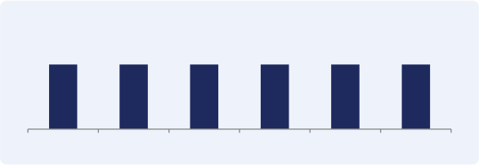
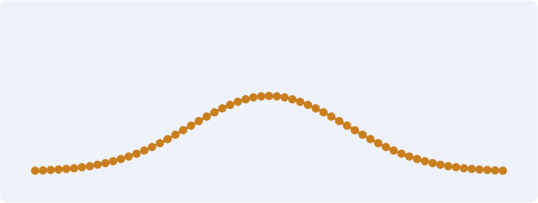
PART I - FOUNDATIONS
Random Variables
• A random outcome is not the same thing as a random variable.
• A random variable X maps outcomes to
numbers, e.g. X = the number shown on a die.
• Uppercase X denotes the variable; lowercase x denotes a realized value.
• Discrete X: finite / countable values
• e.g. clicks, error count, class label
• Continuous X: values fill an interval
• e.g. height, response time, temperature, latency
Discrete
1 2 3 4 5 6
Continuous

Slide 9
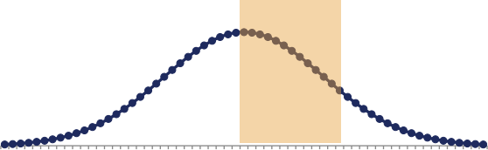
PART I - FOUNDATIONS
PMF, PDF, and CDF
• Discrete X: probability mass function P(X = x) gives probability directly.
• Continuous X: density fX(x); probability = AREA under the curve, not the height.
• For continuous X, P(X = x) = 0 exactly!
• Probability only accumulates over an interval:
• P(a ≤ X ≤ b) = ∫ₐ ᵇ fX(x) dx
• CDF: FX(x) = P(X ≤ x), the accumulated probability up to x.
Area = Probability (shaded region between a and b)
-3.0
-2.8
-2.6
-2.4
-2.2
-2.0
- 1.8
- 1.6
- 1.4
- 1.2
- 1.0
-0.8
-0.6
-0.4
-0.2
0.0
0.2
0.4
0.6
0.8
1.0
1.2
1.4
1.6
1.8
2.0
2.2
2.4
2.6
2.8
3.0
a b
Classic misconception: a tall density value does NOT mean high probability at that exact point -- a single point always has probability zero for continuous
variables.

Slide 10
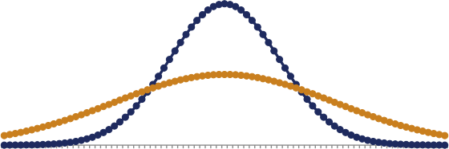
PART I - FOUNDATIONS
Expectation & Variance
• Expectation E[X]: the long-run average value of X.
• E[X] = Σₓ x P(X=x) (discrete) E[X] = ∫ x fX(x) dx (continuous)
• Variance Var(X): how spread out X is around its mean.
• Var(X) = E[(X - E[X])²]
• Standard deviation = √Var(X); larger σ means more fluctuation.
Same Mean, Different Variance
-4.0
-3.7
-3.4
-3.1
-2.8
-2.5
-2.2
-1.9
-1.6
-1.3
-1.0
-0.7
-0.4
-0.1
0.2
0.5
0.8
1.1
1.4
1.7
2.0
2.3
2.6
2.9
3.2
3.5
3.8
σ = 1 (low spread) σ = 2 (high spread)
Both curves are centered at μ = 0, but the wider curve
represents a more uncertain / noisier variable.

Slide 11

PART I - FOUNDATIONS
Independence
• A and B are independent if knowing A occurred tells us nothing new about B.
• P(A∩B) = P(A) × P(B)
• For random variables: P(X=x, Y=y) = P(X=x) P(Y=y) for all x, y.
• Independence is a strong MODELING
assumption, not automatically true.
• AI connection: Naive Bayes assumes features are conditionally independent given the class.
• Real-world variables are often dependent -- e.g. words in a sentence, pixels in an image.
Coin flip
result
Die roll
result
Independent:
knowing the coin tells you
nothing about the die
Word: “free” in an email
Word: “win” in same email
Naive Bayes ASSUMES these are
independent given the class -- in
reality they often co-occur.

Slide 12
PART I - FOUNDATIONS
Conditional Probability: Intuition
• Question: given that B happened, what is the probability of A now?
• Intuition: restrict the world to only the
outcomes where B is true, then ask about A inside that smaller world.
• P(A|B) = P(A∩B) / P(B) for P(B) > 0
• If A and B are independent, P(A|B) = P(A) -- conditioning changes nothing.
• Otherwise, the condition carries real information about A.
A
B
(the new world)
P(A|B) asks: within the shaded B-region, how much ofit is
also A?

Slide 13
PART I - FOUNDATIONS
Worked Example: Conditional Probability
• Problem: Roll a fair die. Let A = “result is even”, B = “result is ≥ 4” . Find P(A|B).
• Step 1: List outcomes. A = {2,4,6}, B = {4,5,6}
• Step 2: Find A∩B = {4,6}, so P(A∩B) = 2/6
• Step 3: P(B) = 3/6
• Step 4: P(A|B) = P(A∩B)/P(B) = (2/6)/(3/6) = 2/3
• Interpretation: once we know the roll is ≥ 4, the chance it is also even rises from 1/2 to 2/3.

Slide 14

PART I - FOUNDATIONS
Law of Total Probability
• If B1,...,Bn partition the sample space completely and exclusively,
• P(A) = Σᵢ P(A|Bᵢ) P(Bᵢ)
• The total probability is a weighted average across all background cases.
• Population disease example:
Young
50%
P(disease)= 5%
Population
Middle
30%
P(disease)=
15%
P(disease) = 0.05(0.5)+0.15(0.3)+0.30(0.2) = 0.107
Overall prevalence in the population is 10.7% -- a weighted blend across subgroups.
Older
20%
P(disease)=
30%

Slide 15

THINK - PAIR - SHARE
A medical test has 90% sensitivity.
Does a positive test mean the patient has a 90% probability of disease?
Discuss with a partner for 60 seconds.
We will answer this rigorously with Bayes' theorem in the next few slides.

Slide 16
PART I - FOUNDATIONS
Bayes' Theorem
• P(A|B) = P(B|A) P(A) / P(B)
• P(A): prior -- belief before seeing evidence
• P(B|A): likelihood -- probability of the evidence if A is true
• P(A|B): posterior -- updated belief after seeing evidence
• P(B): evidence -- overall probability of the observation
• posterior α prior × likelihood
P(A|B) = P(B|A)P(A) / P(B)
Derived directly from the product rule P(A∩B) =
P(A|B)P(B) = P(B|A)P(A).
Used in: naive Bayes classification, medical diagnosis updating, spam filtering from words, information
retrieval.

Slide 17

PART I - FOUNDATIONS
The Bayesian Updating Flow
Prior |  | New Evidence |  | Likelihood |  | Bayesian Update |  | Posterior
Posterior ∝ Prior × Likelihood
New evidence reshapes what we believed before -- the posterior becomes the new starting point for the next update.

Slide 18
PART I - FOUNDATIONS
Worked Example: Medical Diagnosis (Bayes)
• Problem: Disease prevalence P(disease) = 0.01. Test sensitivity P(+|disease) = 0.90. False-positive rate P(+|no disease) = 0.05. Given a POSITIVE test, find P(disease|+).
• Step 1 - Prior: P(disease) = 0.01, P(no disease) = 0.99
• Step 2 - Likelihoods: P(+|disease) = 0.90, P(+|no disease) = 0.05
• Step 3 - Evidence: P(+) = 0.90(0.01) + 0.05(0.99) = 0.0585
• Step 4 - Posterior: P(disease|+) = 0.90(0.01) / 0.0585 ≈ 15.4%
• Interpretation: a positive result does NOT imply high disease probability, because the prior prevalence is low and false positives are common relative to true cases.

Slide 19
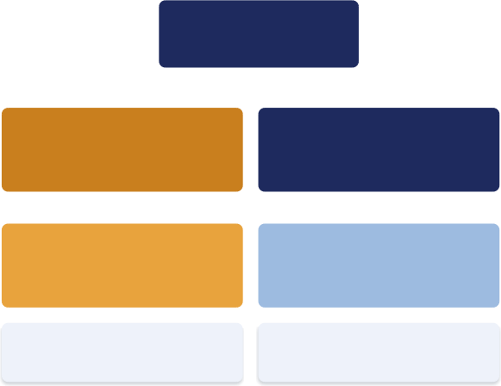

PART I - FOUNDATIONS
Seeing It in Frequencies: 10,000 People
Common Misconception
“Positive test = 90% probability of disease.” This confuses P(+|disease) = 0.90 (the sensitivity)
with P(disease|+) (the posterior).
Among the 585 people who test positive, only 90 actually have the disease -- the other 495 are
false alarms from the huge healthy population.
Answers Think-Pair-Share #1: a 90%-sensitive test on a rare disease can still yield a low
posterior probability.
10,000 people
100 have disease (1%)
90 true positive (90% sensitivity)
10 false negative
9,900 no disease (99%)
495 false positive (5% false-pos rate)
9,405 true negative
Total positive = 90 + 495 = 585
P(disease|+) = 90/585 ≈ 15.4%

Slide 20
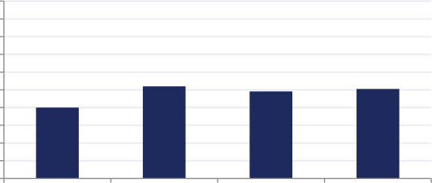
PART I - FOUNDATIONS
Law of Large Numbers
• Question: if we repeat a random trial many times, what happens to the average?
• For i.i.d. random variables with finite mean μ, • X̄ ₙ → μ as n → ∞ (almost surely)
• Illustrated with repeated fair coin tosses:
• Individual outcomes remain random.
• But averages become stable.
Observed Fraction of Heads vs. n
1
0.9
0.8
0.7
0.6
0.5
0.4
0.3
0.2
0.1
0
0.52
100
0.49
1000
0.51
10000
0.40
10
As n grows from 10 to 10,000 tosses, the fraction of heads
settles near 0.5.

Slide 21

PART I - FOUNDATIONS
Central Limit Theorem: Intuition
• Take i.i.d. samples from a distribution with finite mean and variance.
• Compute the sample mean, repeat the
sampling process many times, and standardize the sample mean.
• As the sample size grows, the standardized sample mean approaches a Normal(0,1)
distribution.
• Illustrated below for three very different source distributions.
Uniform(0,1)
n =
1,2,5,10,30,100 sample means
→
Normal(0,1)
Bernoulli(p=0.3)
n =
1,2,5,10,30,100 sample means
→
Normal(0,1)
Exponential(1)
n =
1,2,5,10,30,100 sample means
→
Normal(0,1)

Slide 22
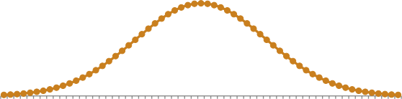
PART I - FOUNDATIONS
Central Limit Theorem: The Formula
• Zn = (1/(σ√ n)) Σᵢ (Xi - μ) ⇒ Normal(0,1)
• Equivalently: X̄ ₙ is approximately Normal(μ, σ²/n) for large n.
• This is why normal approximations support
confidence intervals, and why Gaussian curves emerge from many small independent effects.
• Misconception: CLT does NOT say the original data are Normal.
• It only says the STANDARDIZED SAMPLE MEAN becomes approximately Normal.
Standardized Sample Mean → N(0,1)
-3.0
-2.8
-2.6
-2.4
-2.2
-2.0
- 1.8
- 1.6
- 1.4
- 1.2
- 1.0
-0.8
-0.6
-0.4
-0.2
0.0
0.2
0.4
0.6
0.8
1.0
1.2
1.4
1.6
1.8
2.0
2.2
2.4
2.6
2.8
3.0
AI relevance: explains noisy minibatch gradient behavior in deep learning, and return-estimation error in reinforcement learning.

Slide 23
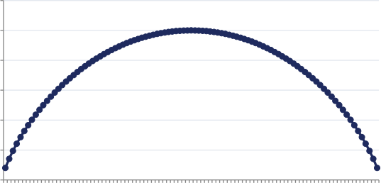
PART I - FOUNDATIONS
Information Theory: Entropy
• Entropy H(X) = -Σₓ P(X=x) log P(X=x)
• Entropy measures uncertainty: higher H(X) = more uncertain outcome.
• Binary example: entropy is highest at p=0.5
(maximum uncertainty), and lowest near p=0 or p=1 (nearly certain).
• Maximum-entropy principle: choose the least- committal distribution consistent with what you know.
• Loosely connects to logistic regression and to Bayesian reasoning without overcommitting.
Binary Entropy Curve H(p)
1.2
1
0.8
0.6
0.4
0.2
0
0.0 1
0.04
0.07
0. 10
0. 13
0. 16
0. 19
0.22
0.25
0.28
0.3 1
0.34
0.37
0.40
0.43
0.46
0.49
0.52
0.55
0.58
0.6 1
0.64
0.67
0.70
0.73
0.76
0.79
0.82
0.85
0.88
0.9 1
0.94
0.97
Peak at p=0.5 (1 bit); entropy → 0 as p → 0 or p → 1
(near-certain outcome).

Slide 24
02
Probability Distributions
Discrete and continuous families, and how to choose one

Slide 25
PART II - DISTRIBUTIONS
Choosing a Distribution: The Map
Data Type | Possible Distribution
Binary outcome (yes/no) | Bernoulli
Number of successes in n trials | Binomial
Event count in an interval | Poisson
Multiple categories | Multinomial
Bounded continuous value | Uniform
Bell-shaped continuous value | Gaussian (Normal)
Waiting time | Exponential
Positive, skewed value | Gamma
A probability parameter | Beta
A probability vector | Dirichlet

Slide 26
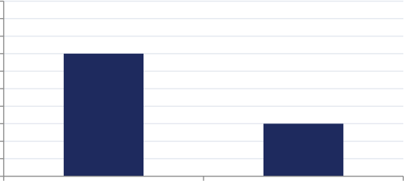
PART II - DISCRETE
Bernoulli Distribution
• What it models: one binary trial
(success/failure, yes/no).
• X ~ Bernoulli(p): P(X=1)=p, P(X=0)=1-p
• E[X] = p, Var(X) = p(1-p)
• AI examples: spam label, dropout mask, sigmoid neural output.
• Assumption: two mutually exclusive outcomes, fixed p across repetitions.
• Limitation: cannot represent more than two outcomes or a time-varying rate.
Bernoulli(p = 0.3)
1
0.9
0.8
0.7
0.6
0.5
0.4
0.3
0.2
0.1
0
0.70
0.30
X=0 X=1

Slide 27
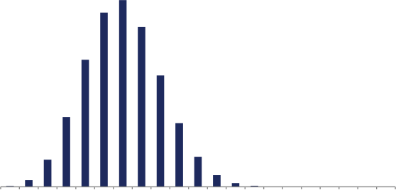
PART II - DISCRETE
Binomial Distribution
• What it models: number of successes in n independent Bernoulli(p) trials.
• P(Y=k) = C(n,k) pᵏ (1-p)ⁿ_ᵏ
• E[Y] = np, Var(Y) = np(1-p)
• AI example: number of purchases among n users in an A/B test.
• Assumption: independence and CONSTANT p across all trials.
• Limitation: social influence or a changing population violates this.
Binomial(n=20, p=0.3)
0 1 2 3 4 5 6 7 8 9 10 11 12 13 14 15 16 17 18 19 20

Slide 28
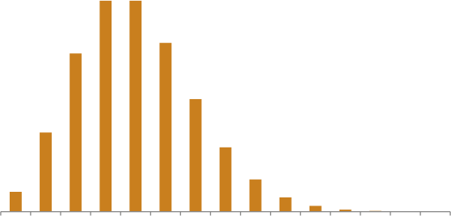
PART II - DISCRETE
Poisson Distribution
• What it models: count of sparse, independent
events per unit time/space. ^{Poisson(λ} ⁼ ⁴⁾
• P(Z=k) = λᵏ e⁻λ / k!
• E[Z] = Var(Z) = λ
• AI examples: clicks per minute, server requests,
word occurrences.
• Assumption: independent, homogeneous-rate events
(Poisson process).
• Fails when: rate changes over time (rush hour) or
events inhibit each other.
0 1 2 3 4 5 6 7 8 9 10 11 12 13 14

Slide 29
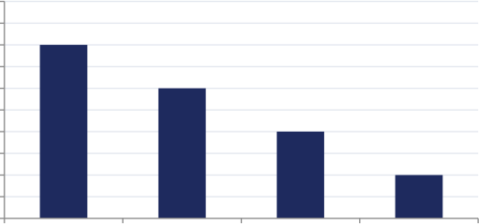
PART II - DISCRETE
Multinomial Distribution
• What it models: counts across K categories after n independent trials.
• P(N₁=k₁,...,N_K=k_K) = n!/(k₁ !…k_K!) ∏ pᵢᵏ ⁱ
• E[Nᵢ] = npᵢ
• AI examples: word counts, topic-model counts, softmax-style category probabilities, epsilon- greedy action choice.
• A softmax output parameterizes a categorical
distribution for one trial. Counts from repeated
categorical trials follow a multinomial distribution.
• Assumption: category probabilities constant across trials.
• Limitation: cannot capture order or drifting
probabilities -- needs sequential models (HMM, RNN).
Example: 4-Category Probabilities
0.5
0.45 0.4
0.35 0.3
0.25 0.2
0.15 0.1
0.05 0
0.40
0.30
0.20
0.10
Topic A Topic B Topic C Topic D

Slide 30
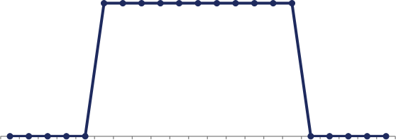
PART II - CONTINUOUS
Uniform Distribution (Brief)
• fU(x) = 1/(b-a) for x∈[a,b], zero otherwise
• E[U] = (a+b)/2, Var(U) = (b-a)²/12
• AI uses: weight initialization, action exploration, Monte Carlo sampling, random image crops.
• Assumption: every value in the range is equally likely.
• Limitation: rarely matches peaked real data; no proper uniform over the whole real line.
Uniform(0,1) Density
-0.5 -0.4 -0.3 -0.2 -0.1 0.0 0.1 0.2 0.3 0.4 0.5 0.6 0.7 0.8 0.9 1.0 1.1 1.2 1.3 1.4 1.5

Slide 31

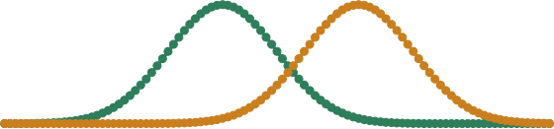
PART II - CONTINUOUS
Normal Distribution: Shape
• fX(x) = 1/(σ√ (2π)) exp(-(x-μ)²/(2σ² ))
• μ = center of the curve (location).
• σ = spread of the curve (scale).
• Symmetric, unimodal, light-tailed, defined on the whole real line.
• Normal(0,1) is called the standard normal.
Same μ, Different σ
μ=0, σ=1 μ=0, σ=2
Different μ, Same σ
-- μ=-1, σ=1 -- μ=1.5, σ=1

Slide 32

PART II - CONTINUOUS
Normal Distribution: AI Connections & Limits
• AI connections:
• Linear regression error, Gaussian Naive Bayes, GMMs, Kalman filters
• VAE latent variables, GAN input noise
• “Not every dataset is Gaussian.”
• Heavy-tailed data (finance), non-negative data
(durations), multimodal data (clusters) all break the Gaussian assumption.
Linear
Regression
Gaussian Naive Bayes
GMM
Clustering
Kalman Filters
VAE Latent Space
GAN Input Noise
Multimodal image-pixel intensities, for example,
cannot be captured by a single Gaussian -- a mixture model is needed.

Slide 33
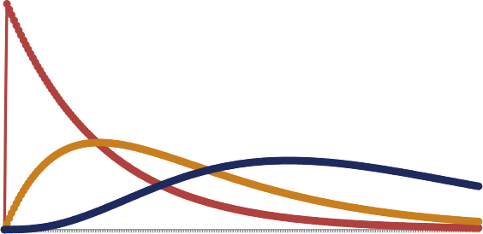
PART II - CONTINUOUS
Exponential & Gamma Distributions
• Exponential: waiting time of a memoryless process
• fT(t) = λe⁻λᵗ, E[T]=1/λ, Var(T)=1/λ²
• For integer shape α, Gamma can be viewed as the waiting time until the α-th event in a Poisson
process.
• E[X]=αβ, Var(X)=αβ² (shape α, scale β)
• Exponential = Gamma with shape α = 1
• Memoryless assumption often fails (aging products, buses); Gamma/Weibull relax it.
Exponential = Special Case of Gamma
Gamma(α=1)=Exp Gamma(α=2) Gamma(α=4)
0.00
0.13
0.25
0.38
0.50
0.63
0.75
0.88
1.00
1.13
1.25
1.38
1.50
1.63
1.75
1.88
2.00
2.13
2.25
2.38
2.50
2.63
2.75
2.88
3.00
3.13
3.25
3.38
3.50
3.63
3.75
3.88
4.00
4.13
4.25
4.38
4.50
4.63
4.75
4.88
5.00

Slide 34
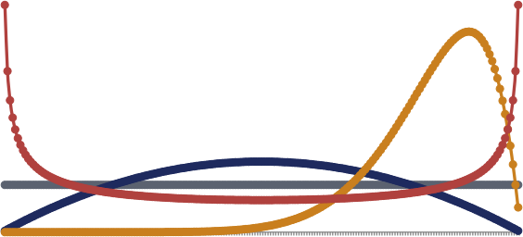
PART II - CONTINUOUS
Beta Distribution: Modeling Uncertainty About a
Probability
• Beta lives on [0,1] -- it represents uncertainty about a probability, not an outcome itself.
• Bernoulli models an outcome. Beta models uncertainty about the probability p itself.
• Example question: “What is the true click-
through rate?” -- that's a Beta question, not a Bernoulli one.
• α and β behave like prior count parameters in Beta–
Bernoulli updating. When α, β > 1, α-1 and β-1 can be interpreted approximately as prior successes and prior failures.
Beta Shapes
0.01
0.03
0.06
0.08
0.10
0.13
0.15
0.18
0.20
0.23
0.26
0.28
0.30
0.33
0.35
0.38
0.41
0.43
0.46
0.48
0.51
0.53
0.56
0.58
0.60
0.63
0.66
0.68
0.70
0.73
0.76
0.78
0.81
0.83
0.85
0.88
0.91
0.93
0.95
0.98
Beta(1,1) Beta(2,2) Beta(10,2) Beta(0.5,0.5)

Slide 35
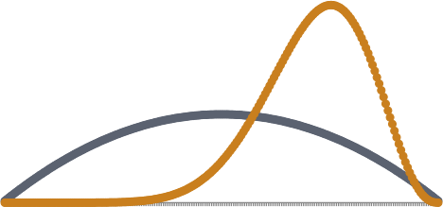
PART II - CONTINUOUS
Worked Example: Beta-Bernoulli Updating
• Problem: Prior belief about click-through rate p is Beta(2,2). We observe 8 successes and 2 failures. Find the posterior.
• Step 1: Beta is conjugate to Bernoulli/Binomial likelihoods.
• Step 2: Update rule: Beta(α,β) + s successes, f failures → Beta(α+s, β+f)
• Step 3: α_new = 2 + 8 = 10, β_new = 2 + 2 = 4
• Step 4: Posterior = Beta(10, 4)
• Interpretation: the posterior mean shifts from 0.5 (prior) toward 10/14 ≈ 0.71, reflecting the observed high success rate.
Prior → Data → Posterior
0.01
0.04
0.07
0.10
0.13
0.15
0.18
0.21
0.24
0.28
0.30
0.34
0.36
0.40
0.42
0.46
0.48
0.52
0.55
0.57
0.60
0.64
0.67
0.69
0.72
0.76
0.79
0.81
0.84
0.88
0.91
0.94
0.96
0.99
Prior Beta(2,2) Posterior Beta(10,4)
The posterior is sharper and shifted right -- 10
data points concentrated our belief.

Slide 36
PART II - CONTINUOUS
Dirichlet Distribution: “Beta for Multiple Categories”
• Beta describes uncertainty about ONE probability (two outcomes).
• Dirichlet describes uncertainty about a PROBABILITY VECTOR over K categories.
• Lives on the simplex: zᵢ ≥ 0, Σᵢ zᵢ = 1
• Applications: topic models (LDA), multinomial smoothing, Bayesian naive Bayes.
• Equal concentration parameters = symmetric prior; large αi favors category i.
Category A
Category B Category C
A sample from Dirichlet(α) is a point on this triangle -- a
full probability vector over 3 categories.

Slide 37

PART II - DISTRIBUTIONS
Exponential Family: One Shared Structure
• Bernoulli, Binomial, Poisson, Normal,
Exponential, Gamma, Beta, Dirichlet all share one general form.
• f(x;η) = h(x) exp(η·T(x) - A(η))
• η = natural parameter, T(x) = sufficient statistic, A(η) = log-partition function
• Why AI/statistics like this family:
• Computational convenience, sufficient statistics, conjugate priors, generalized linear models.
Bernoulli
Poisson
Exponential
Beta
Binomial
Normal
Gamma
Dirichlet

Slide 38

PART II - DISTRIBUTIONS
Model Selection: A Distribution Is an Assumption
• Don't pick Gaussian just because it's familiar.
• Consider: support, symmetry, tails,
multimodality, independence, data size, interpretability.
• A misspecified distribution introduces
systematic bias -- e.g. a single Gaussian on multimodal pixel data.
• Simple decision tree:
Binary?
Count?
Positive continuous?
Real-valued,
symmetric?
A probability?
A probability vector?
→ Bernoulli
→ Poisson / alternatives → Exponential / Gamma
→ Gaussian (baseline)
→ Beta
→ Dirichlet

Slide 39
03
Statistical Inference
MLE, method of moments, MAP, and full Bayesian inference

Slide 40

PART III - INFERENCE
The Problem: Unknown Parameters
• We observe data D = {x1, ..., xn}.
• The model has an unknown parameter θ (e.g. a Gaussian's μ and σ, or a Poisson's λ).
• How do we estimate θ from D?
• Four approaches: MLE, Method of Moments, MAP, and full Bayesian inference.
Data
D = {x1,...,xn}
Model p(x|θ)
θ unknown
MLE
MOM
MAP
Bayesian
Four estimation strategies covered in this part.

Slide 41

PART III - M LE
Maximum Likelihood Estimation: Intuition
• Idea: choose the parameter value that makes the observed data MOST LIKELY.
• θ̂_MLE = argmax_θ p(D|θ)
• For i.i.d. data: L(θ;D) = ∏ᵢ p(xᵢ|θ)
• We maximize the LOG-likelihood instead:
• log L = Σᵢ log p(xᵢ|θ)
• Why log? Turns a product into a sum -- easier to differentiate and numerically stable.
Try many θ values
Compute likelihood of
observed data for each θ
Pick θ that makes data
most probable → θ̂_MLE

Slide 42
PART III - M LE
Worked Example: Bernoulli MLE
• Problem: 100 users visit a page; 70 click. Estimate the click probability p.
Step 1: L(p) = p^{N1} (1-p)^{N0}, with N1=70 (successes), N0=30 (failures)
• Step 2: log-likelihood ℓ(p) = N1 log p + N0 log(1-p)
• Step 3: Set derivative to zero: N1/p - N0/(1-p) = 0
• Step 4: Solve → p̂ = N1/n = 70/100 = 0.70
• Interpretation: the MLE is simply the observed success fraction. This connects directly to cross-entropy training in neural nets -- minimizing cross-entropy is maximizing likelihood.

Slide 43
PART III - M LE
Gaussian MLE
• μ̂ = x̄ = (1/n) Σᵢ xᵢ (sample mean)
• σ̂²_MLE = (1/n) Σᵢ (xᵢ - x̄)² (MLE of variance)
• The MLE uses denominator n. The unbiased sample variance uses denominator n-1.
• Why is the mean “everywhere” in statistics and ML? Because under a Gaussian model, the
sample mean IS the maximum-likelihood estimator of μ .
• Under Gaussian regression errors, maximizing likelihood ≡ minimizing mean-squared error.
This is why mean-squared-error loss is so common in AI: for Gaussian-distributed errors, MSE
minimization and likelihood maximization are the same optimization problem.

Slide 44

PART III - MOM
Method of Moments
• Idea: set theoretical moments equal to sample moments, then solve for θ .
• mᵣ(θ) = Eθ[Xʳ] set equal to m̂ ᵣ = (1/n)Σᵢ xᵢʳ
• Examples: Poisson mean estimator, Bernoulli frequency estimator.
• Pros: often simple, avoids a complicated likelihood.
• Cons: can be less efficient than MLE, may yield
invalid parameter values, higher moments are noisy.
Theoretical moment
Eθ[Xʳ]
set equal to
Sample moment
(1/n) Σ xᵢʳ
solve for θ
θ̂_MOM

Slide 45

THINK - PAIR - SHARE
Which distribution would you choose?
(A) Number of users arriving per minute
(B) Whether an email is spam
(C) Probability that a user clicks an ad
(D) Waiting time between server requests
Match each to: Poisson, Bernoulli, Beta, Exponential. Discuss, then check the answer in the speaker notes.

Slide 46

PART III - MAP
MAP vs. MLE
• MLE maximizes the likelihood alone: θ̂_MLE = argmax_θ p(D|θ)
• MAP maximizes likelihood × prior:
• θ̂_MAP = argmax_θ p(D|θ) p(θ)
• Gaussian prior on weights → L2 penalty → ridge regression
• Laplace prior on weights → L1 penalty → lasso
• Regularization = prior belief, expressed as an optimization penalty.
MLE:
Data → Estimate
MAP:
Prior + Data → Estimate
MAP anchors the estimate using prior belief, especially
useful with little data.

Slide 47

THINK - PAIR - SHARE
You have only 5 observations, but strong prior knowledge. MLE or MAP?
Discuss with a partner. We will compare MLE, MAP, and full Bayesian inference on the next slides.

Slide 48
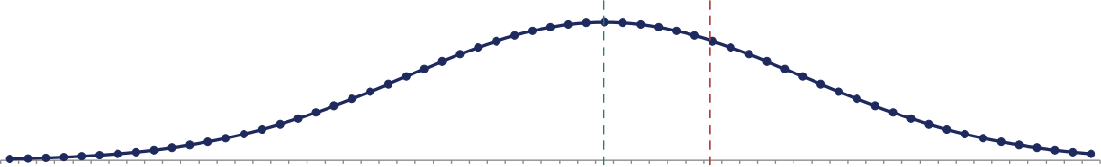
PART III - INFERENCE
MLE vs. MAP vs. Full Bayesian Inference
Question | MLE | MAP | Bayesian
What is θ? | Fixed, unknown value | Fixed, unknown value | A random variable
Output | Single point estimate | Posterior mode (single point) | Full posterior distribution
Uses a prior? | No | Yes | Yes
Captures uncertainty? | No | No | Yes
-3.0
-2.9
-2.8
-2.7
-2.6
-2.5
-2.4
-2.3
-2.2
-2.1
-2.0
-1.9
-1.8
-1.7
-1.6
-1.5
-1.4
-1.3
-1.2
-1.1
-1.0
-0.9
-0.8
-0.7
-0.6
-0.5
-0.4
-0.3
-0.2
-0.1
0.0
0.1
0.2
0.3
0.4
0.5
0.6
0.7
0.8
0.9
1.0
1.1
1.2
1.3
1.4
1.5
1.6
1.7
1.8
1.9
2.0
2.1
2.2
2.3
2.4
2.5
2.6
2.7
2.8
2.9
3.0
Posterior Distribution, with MLE and MAP as Single Points on It
θ̂MAP θ̂MLE
Point estimate (MLE / MAP) Full uncertainty distribution (posterior curve)

Slide 49


PART III - BAYESIAN
Full Bayesian Inference
• p(θ|D) = p(D|θ) p(θ) / p(D)
• Posterior predictive: p(x_new|D) = ∫ p(x_new|θ) p(θ|D) dθ
• Instead of pretending θ is known exactly,
Bayesian inference averages predictions over our uncertainty in θ .
• When exact integration is impossible: MCMC, importance sampling, variational inference
(approximations -- not covered in depth here).
Prior p(θ)
+ Data D
→ Posterior p(θ|D)
→ Average over θ for posterior predictive

Slide 50

PART III - INFERENCE
Training & Inference Workflow
Choose prior
(if
Bayesian)
Estimate
/
infer
params
Choose model
Choose
distributi
on
Write likelihood
Validate
assumpti
ons
Evaluate on
held-out data
Quantify
uncertain
ty
Deploy / revise
Statistical inference is not just optimization -- model assumptions must be checked.
Medical priors may come from experts; image models should account for correlations among neighboring pixels.

Slide 51
04
Probabilistic Models in AI
Generative vs discriminative, graphical models, HMMs, and deep learning

Slide 52

PART IV - MODELS
Generative vs. Discriminative Models
• Generative: learns p(x,y) or p(x)
• Can generate data, model the input distribution, handle missing data.
• Example: Naive Bayes
• Discriminative: learns p(y|x) or a decision boundary
• Discriminative models directly model p(y|x) or the decision boundary.
• They focus on predicting y from x without explicitly modeling how x is generated.
• Example: logistic regression, deep classifiers
y x
Generative: y → x (models how data is generated)
x y
Discriminative: x → y (models the prediction boundary directly)
(This arrow picture is intuition, not strict mathematical direction.)

Slide 53
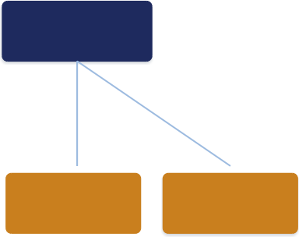

PART IV - GRAPHICAL MODELS
Bayesian Networks
• Nodes = random variables. Edges =
dependencies.
• P(x1,...,xn) = ∏ᵢ P(xᵢ | Parents(xᵢ))
• A node is independent of non-descendants given its parents.
• Observing symptoms updates our belief about the disease -- Bayes' theorem running on a
graph.
Disease
Fever
Cough Test
Observing “Fever” and “positive Test” updates P(Disease)
via the shared parent structure.

Slide 54
PART IV - GRAPHICAL MODELS
Markov Random Fields
• Undirected edges express symmetric
• P(x) = (1/Z) ∏_C Ψ_C(x_C)
compatibility, not causal direction.
• Z is a normalizing constant (often hard to
• Image segmentation: neighboring pixels tend to have similar labels.
• Bayesian networks: directed, causal. MRFs:
undirected, compatibility constraints.
Neighboring pixels of the same color (label) reinforce each
other -- a small image-segmentation grid.
compute exactly).

Slide 55

PART IV - TEMPORAL MODELS
Markov Chains
• First-order Markov assumption:
• P(sₜ | sₜ-1, sₜ-₂, ...) = P(sₜ | sₜ-1)
• “The future depends only on the present, not the full history.”
• Example: weather tomorrow depends only on weather today, not last week.
• Key parameters: initial distribution + transition matrix aij = P(sₜ=j | sₜ-1=i).
Sunny Rainy Cloudy
s(t-1) → s(t) → s(t+1): each next state depends only on
the current one.

Slide 56

PART IV - TEMPORAL MODELS
Hidden Markov Models (1/2)
• The state is hidden; we only observe an emission.
• Hidden = user intent, observed =
click/search/purchase.
• OR: hidden = phoneme, observed = audio signal.
• P(s1:T, o1:T) = P(s1)P(o1|s1) ∏ₜ P(sₜ |sₜ₋₁ )P(oₜ |sₜ )
s1 s2 s3 s4
o1 o2 o3 o4
Hidden states s1→s2→s3→s4 emit observations o1..o4.

Slide 57
PART IV - TEMPORAL MODELS
Hidden Markov Models (2/2): Three Classic Algorithms
Forward Algorithm
Computes P(o1:T) -- the
probability of the observed
sequence.
Viterbi Algorithm
Finds the single most likely hidden-state sequence.
Baum-Welch (EM)
Learns the model's parameters
from data.
Named here without derivation -- the point is knowing what each algorithm is FOR.

Slide 58

PART IV - DEEP LEARNING
Statistics in Deep Learning: Overview
• Probability is not separate from deep learning -- it's built in.
• Softmax & cross-entropy, calibration
• Dropout & Monte Carlo uncertainty, Bayesian neural networks
• GANs and VAEs as probabilistic generative models
• Uncertainty-aware regression, ensembles
Softmax Cross-Entropy Dropout
Bayesian NN
Uncertainty Regression
GANs
Ensembles
VAEs
Calibration

Slide 59

PART IV - DEEP LEARNING
Softmax, Cross-Entropy & Calibration
• p̂ ₖ = exp(z ₖ ) / Σⱼ exp(zⱼ) (softmax: logits → normalized scores)
• Cross-entropy training is maximum likelihood for the correct class.
• A softmax score is NOT automatically a calibrated probability.
• Calibration check: among predictions made with 80% confidence, are about 80% actually correct?
• Temperature scaling can correct over/under- confident softmax outputs.
Logits
z1, z2, z3
Softmax
Normalized scores (NOT auto-calibrated!)

Slide 60

PART IV - DEEP LEARNING
Dropout & Uncertainty
• Dropout uses a Bernoulli random mask to
disable units -- probability lives directly inside the network.
• Monte Carlo dropout: run multiple stochastic
forward passes → estimate predictive uncertainty.
• Bayesian neural networks (more general idea): place a prior on weights w, infer p(w|D).
• BNNs reveal where a model “doesn't know”, but are computationally expensive.
Same input x
Forward pass 1
(dropout mask
A)
Forward pass 2
(dropout mask
B)
Forward pass 3
(dropout mask
C)
Spread of outputs → predictive uncertainty

Slide 61

PART IV - DEEP LEARNING
GANs & VAEs: A Probability Perspective
• GAN: generator G(z) produces samples; goal is Pg ≈ Pdata
• Implicit distribution, no explicit likelihood. Mode collapse = some modes of Pdata are missed.
• VAE: latent z, prior p(z), decoder p(x|z), encoder q(z|x)
• VAE training maximizes the ELBO (Evidence Lower Bound), shown in full on the right.
GAN
z → G(z) → x
(implicit distribution)
VAE
z ~ p(z) → decoder → x
encoder q(z|x) ← x
^{L(θ,φ)} ⁼ ^{E}qφ(z|x) ^{[log} ^{p}θ ^{(x|z)]} ⁻ ^{D}KL ^{(q}φ ^{(z|x)} ‖ ^{p(z))}
First term (reconstruction): fits the data. Second term (KL
regularization): stays close to the prior.
No architecture deep-dive --just the probabilistic role of
each piece.

Slide 62
05
Practical Applications
Spam filtering, diagnosis, recommendation, segmentation, and RL under uncertainty

Slide 63
PART V - CASE STUDIES
Case Study: Spam Filtering with Naive Bayes
Problem | Probabilistic Model
Classify an incoming message as spam or normal from its words. |  | P(Y=spam|x) “ P(Y=spam) ∏ᵢ P(Xᵢ=xᵢ|Y=spam)
Inference
Decision
Estimate word likelihoods and class prior from training data.
Pick class with larger posterior; report a spam probability; threshold
Laplace smoothing
(e.g. 0.9) for auto- blocking.
Prior P(spam)
× Word likelihoods P(word|spam)
Posterior
P(spam|words)
Independence assumption is strong, but the model is transparent, fast, and hard to beat as a baseline.

Slide 64
PART V - CASE STUDIES
Case Study: Medical Diagnosis (Recap)
Problem
Probabilistic Model
Inference
Decision
Estimate P(disease | test result) from prevalence and test |  | Prior = population prevalence. Likelihood = test sensitivity / |  | Bayes' theorem combines prior and likelihood into a |  | 1% prevalence + 90% sensitivity + 95% specificity → positive
accuracy. specificity. posterior, as computed test gives only ≈15.4%
Echoes the Bayes worked example from Part I: doctors need MORE than a single positive test before concluding
high disease probability -- a Bayesian network can combine several tests, symptoms, and expert priors coherently.

Slide 65

PART V - CASE STUDIES
Case Study: Recommendation Systems
Problem
Predict a user's rating
for an item they haven't rated -- especially hard for new users/items.
Probabilistic Model
Bayesian matrix
factorization: latent user/item factors get priors.
Inference
Compute a posterior
over latent factors;
predict a rating WITH an uncertainty interval.
Decision
“Predicted 4 stars, 80% confidence.” High
uncertainty can drive cautious exploration.
User × Item Rating Matrix (mostly empty)
Bayesian
Latent Factors
Prediction: 4★ 80% confidence

Slide 66
PART V - CASE STUDIES
Case Study: Image Segmentation
Problem
Probabilistic Model
Inference
Decision
Label each pixel as foreground or background from color
P(Y|X) “ exp(Σᵢ log P(Xᵢ|Yᵢ) + β Σ neighbor- agreement) (MRF/CRF-
MAP solution ≈ an energy-minimization / graph-cut problem.
Combines per-pixel color evidence with a smoothness prior --
evidence and spatial
style)
better than
contex | t
thresholding alone.
Pixel-color evidence + neighbor consistency → segmentation.
CRF post-processing applies the same idea to smooth CNN outputs.

Slide 67

PART V - CASE STUDIES
Case Study: Reinforcement Learning Under Uncertainty
Problem
The agent doesn't observe the true environment state perfectly (partially
Probabilistic Model
Maintain a belief
distribution over
possible states.
Inference
Bayesian update after each observation;
predict next belief with the action-conditioned
Decision
Action selection can
account for risk, not just expected return (e.g.
penalize variance,
Broad belief
(uncertain position)
Robot moves
New landmark observation
Posterior belief concentrates
RL is not only about maximizing expected reward -- uncertainty and risk also matter.

Slide 68

CLOSING
Chapter Integration
Events & Variables
Probability Distributions
Parameter Learning
Probabilistic AI Models
Decisions Under Uncertainty
Foundations Distributions Inference AI Models Applications
Every arrow above is a chapter of this deck: what we observe, how we model it, how we learn its parameters, how AI
systems encode it, and how it drives real decisions.

Slide 69
CLOSING
Common Misconceptions
• 1. Probability density ≠ probability (a point always has probability 0 for continuous X).
• 2. P(A|B) ≠ P(B|A) -- conditioning direction matters.
• 3. A positive test does not imply a high posterior probability of disease.
• 4. CLT does NOT mean the original data are Gaussian -- it's about standardized sample averages.
• 5. Softmax confidence is not automatically a calibrated probability.
• 6. Independence is a modeling assumption, not a universal fact.
• 7. MLE gives a point estimate, not the complete uncertainty picture.
• 8. A familiar distribution (e.g. Gaussian) isn't necessarily the correct model.

Slide 70

FINAL SUMMARY
1. Probability is the language for uncertainty.
2. A distribution is a modeling assumption, not a fact.
3. Data let us estimate unknown parameters.
4. Bayesian methods combine prior knowledge with evidence.
5. AI systems should quantify uncertainty, not just predict.
“The key question is not only ‘What does the model predict?’ but also: ‘How certain should we be about that prediction?’”

Slide 71
A
Appendix: Deeper Math
MLE derivations, Fisher information, asymptotic normality, extra distribution formulas Not required in-class content -- instructor / exam reference only.

Slide 72
APPENDIX
Gaussian MLE: Full Derivation
• L(μ,σ) 〓 Πᵢ (1/(σ√ (2π))) exp(-(xᵢ-μ)2/(2σ2))
• ℓ(μ,σ) 〓 -(n/2)log(2π) - n log σ - (1/(2σ2)) Σᵢ(xᵢ-μ)2
• ∂ℓ/∂μ 〓 0 → μ^ 〓 -x 〓 (1/n) Σᵢ xᵢ
• ∂ℓ/∂σ2 〓 0 → σ^2 〓 (1/n) Σᵢ (xᵢ - -x)2
• Note: this MLE variance divides by n, and is biased downward relative to the unbiased n-1 denominator.

Slide 73
APPENDIX
Bernoulli, Exponential, Poisson MLE Derivations
Bernoulli: L(p) = p^{N1} (1-p)^{N0}, ℓ(p) = N1 log p + N0 log(1-p)
• Score equation: N1/p - N0/(1-p) = 0 → p̂ = N1/n
• Exponential: L(λ) = λ ⁿ exp(-λΣᵢxᵢ) → λ̂ = 1/x̄
Poisson: L(λ) = ∏ᵢ λ^{xᵢ} e^{−λ} / xᵢ! → λ̂ = (1/n)Σᵢ xᵢ = x̄
• All three MLEs reduce to a simple, familiar descriptive statistic (a fraction or a sample mean).

Slide 74
APPENDIX
Worked Example: Exponential MLE (Service Waiting Times)
• Problem: 30 service waiting times, sample mean x̄ = 1.283 hours. Fit an exponential model.
• Step 1: For exponential data, λ̂ = 1/x̄
• Step 2: λ̂ = 1/1.283 ≈ 0.779 per hour
• Step 3: Fisher information I(λ) = n/λ² → SE(λ̂) ≈ λ̂/√ n = 0.779/√30 ≈ 0.142
• Step 4: Approximate 95% interval: [0.500, 1.058]
• Interpretation: the estimate carries a quantified uncertainty band, not just a point value.

Slide 75
APPEND l X
Fisher Information & Asymptotic Normality
• Observed Fisher information: |(θ̂) = -ℓ丨丨(θ̂)
• Approximate variance: Var(θ̂) ≈ |(θ̂)_1
• Under regularity conditions, MLE is consistent and asymptotically normal:
• √ n (θ̂ - θ*) ⇒ Normal(0, l(θ*)_1)
• MLE can attain the Cramér-Rao lower bound.
• Small samples: bias and large variance are possible; boundary cases (e.g. all-success Bernoulli) give p̂=1 with no automatic uncertainty measure.

Slide 76
APPENDIX
Extra Distribution Formulas
Distribution | Density | Moments / Notes
Gamma | f(x) = x^{α_1} e^{_x/β} ⁄ [Γ(α)β^{α} ], x > 0 | E[X]=αβ, Var(X)=αβ²
Beta | f(y) = Γ(α+β) ⁄ [Γ(α)Γ(β)] · y^{α_1} (1_y) ^{β_1} | E[Y]=α/(α+β)
Dirichlet | f(z) = Γ(Σαi) ⁄ ∏Γ(αi) · ∏ zi^{αi_1} | E[zi]=αi/Σαj
Exponential family | f(x;η)=h(x)exp(η·T(x)-A(η)) | η natural param, T(x) sufficient stat
Reference table for denser formulas mentioned briefly in the main lecture.

Slide 77
APPENDIX
Extra Bayesian Formulas: Conjugate Updates
• Beta-Bernoulli: Beta(α,β) + N1 successes, N0 failures → Beta(α+N1, β+N0)
• Dirichlet-Multinomial: Dirichlet(α) + category counts k → Dirichlet(α + k)
• Gamma-Poisson: Gamma(a,b) + Poisson counts → updated Gamma posterior
• Conjugacy makes Bayesian updating analytic and fast -- no numerical integration needed.
• When no conjugate form exists: MCMC, importance sampling, or variational inference approximate the posterior.

